Slide 1
Generative AI

Slide 2
What is generative AI?

Slide 3
Concept overview
Generative artificial intelligence (AI) is a type of AI system capable of generating text, images, or other media in response to prompts. Generative AI models learn the patterns and structure of their input training data and then generate new data with similar characteristics.

Slide 4
Advancements in Generative AI
Advancements in transformer-based deep neural networks, particularly large language models (LLMs), have driven a surge in generative AI systems in the early 2020s. Notable examples include chatbots like ChatGPT, Copilot, Gemini, and LLaMA; text-to-image generation systems such as Stable Diffusion, Midjourney, and DALL-E; and text-to-video AI generators like Sora.

Slide 5
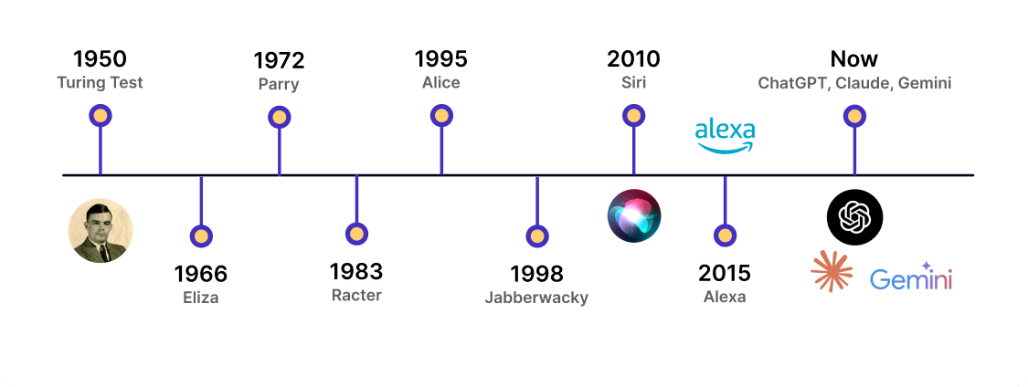
Chatbots: Transforming Human-AI Interaction

Slide 6
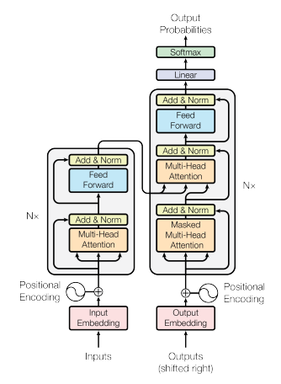
Chatbots: The Modern Era Begins with Transformers
In 2017 Google presents the paper Attention is All You Need, marking a major revolution in NLP.
An innovative architecture that took the concept of self-attention to a new level.
Currently, the paper has been cited in over 140,000 articles.

Slide 7
How GPT Models Work
GPT models are based on the Transformer architecture, utilizing attention mechanisms to process and generate human-like text. They predict the next word in a sequence by considering the context provided by previous words, enabling tasks such as language translation, text summarization, and conversational AI.

Slide 8
Self attention
The model can look at all the words in a sentence simultaneously and determine which ones are important in each context.
For example, in the sentence "The cat looks at the fish and wants to eat it," the model understands that "it" refers to the fish, not the cat.
When you ask a question, the model calculates the most likely next word, then the next one, and so on.

Slide 9
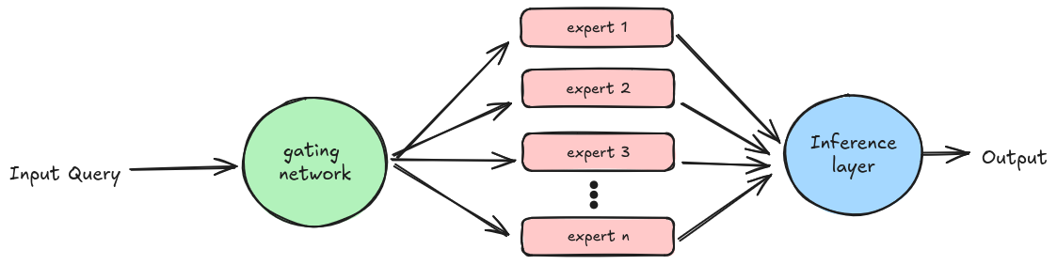
Mixture of experts (MOE)

Slide 10
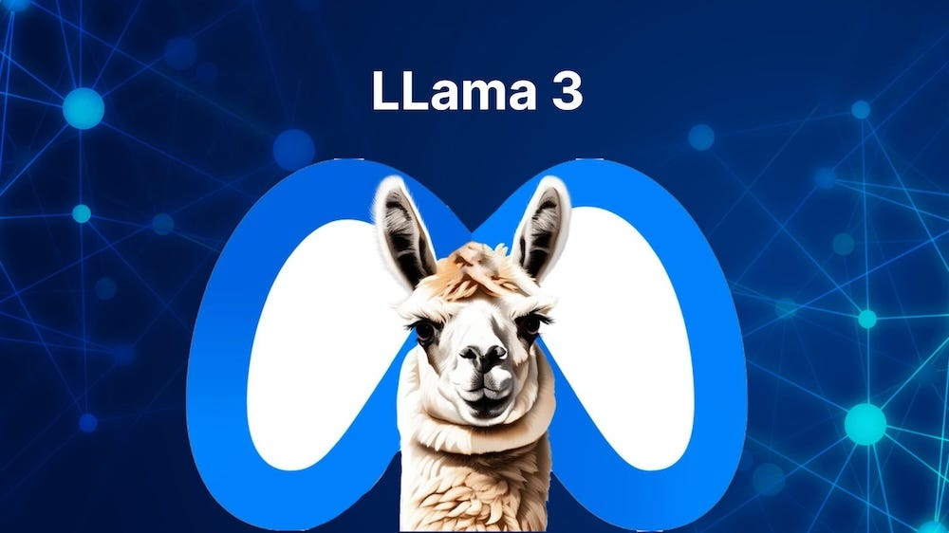


Notable Language Models Beyond ChatGPT

Slide 11
Generative AI: Images

Slide 12
Generative AI: Image Generation Models
Image generation models use deep learning architectures, often based on diffusion models, GANs (Generative Adversarial Networks), or transformers. They learn from large datasets of images and captions, understanding patterns, features, and relationships.
When given a text prompt, these models generate new images by mapping the text's meaning into a visual representation through multiple neural network layers, progressively refining the image until a realistic result is produced.

Slide 13

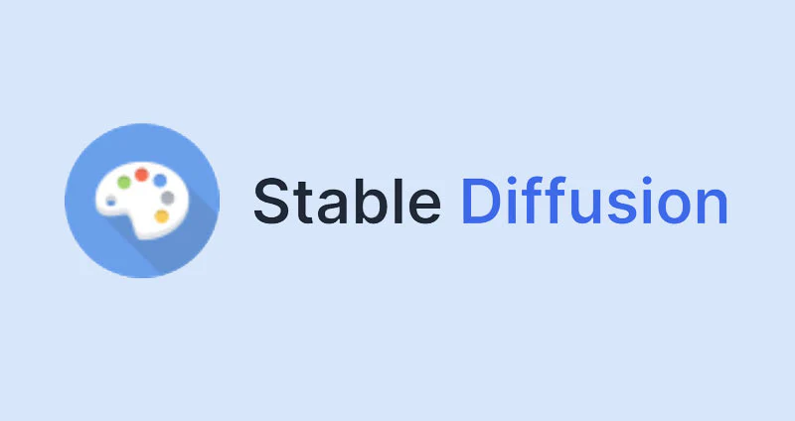

Generative AI: Image Generation Models

Slide 14

Generative AI: Midjourney

Slide 15
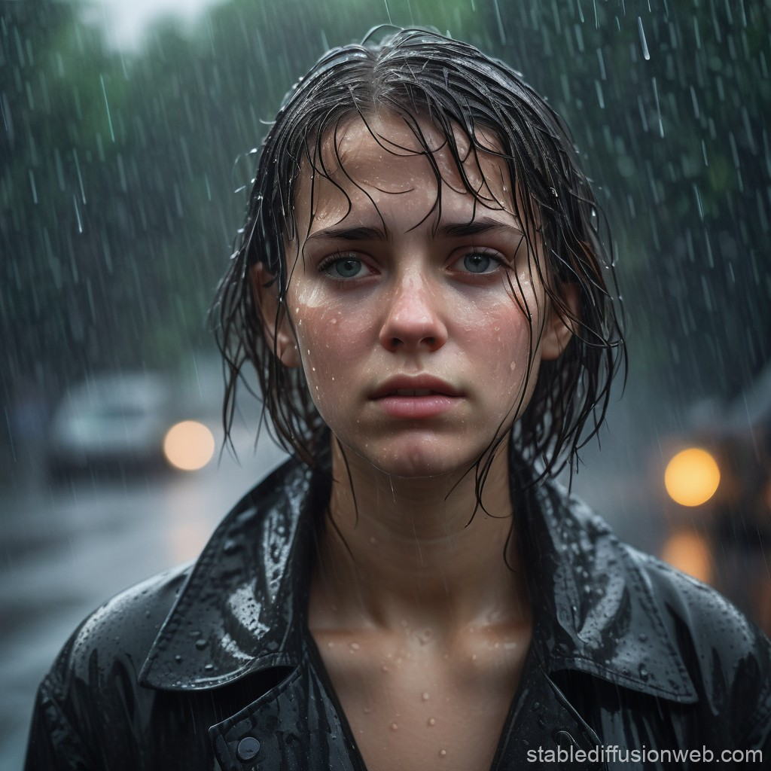
Generative AI: Stable Diffusion

Slide 16
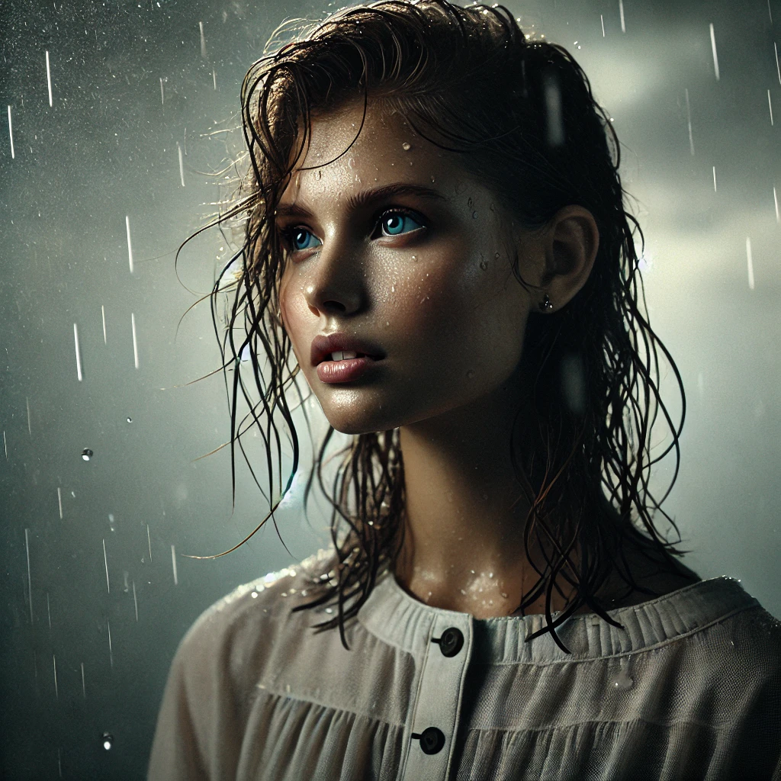
Generative AI: Dall-e

Slide 17
Generative AI: Video

Slide 18
Generative AI: Video Generation Models
Video generation models build on similar principles as image generation models but add a temporal dimension. They use deep learning techniques like GANs, transformers, and diffusion models adapted for sequential data.
These models generate frames while ensuring temporal consistency, learning motion dynamics and visual details from extensive video datasets. Given a text prompt or an initial frame, they predict subsequent frames to create smooth, coherent video sequences.

Slide 19
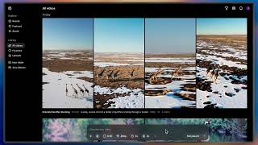
Generative AI: Sora

Slide 20

Generative AI: Mochi 1

Slide 21
But What About Video Games?

Slide 22
Immersive Dialogues with Generative AI
Personalized NPC Interactions:
Use LLMs to create dynamic and context-aware dialogue.
NPCs can remember past conversations and adapt responses.
Procedural Storytelling:
Generate branching storylines based on player choices.
Unique narrative paths driven by AI-created content.

Slide 23
Immersive Dialogues with Generative AI
Real-Time Dialogues:
Enable live conversation generation in multiplayer RPGs.
Characters respond naturally to player input through text or voice.
Emotional Responses:
AI-powered NPCs can detect player emotion through text/voice input.
Generate emotional responses for deeper engagement.

Slide 24
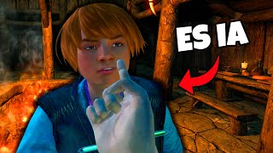
Immersive dialogues

Slide 25
Understanding sentence similarity
Definition
The process of determining how similar two sentences are based on their meaning, context, and structure.
Why It Matters?
Enables tasks like search engines, chatbots, and game dialogue matching.
Example:
Sentence 1: "The hero saved the princess."
Sentence 2: "The knight rescued the royal daughter."
Similarity Score: High (Similar meaning despite different words).

Slide 26
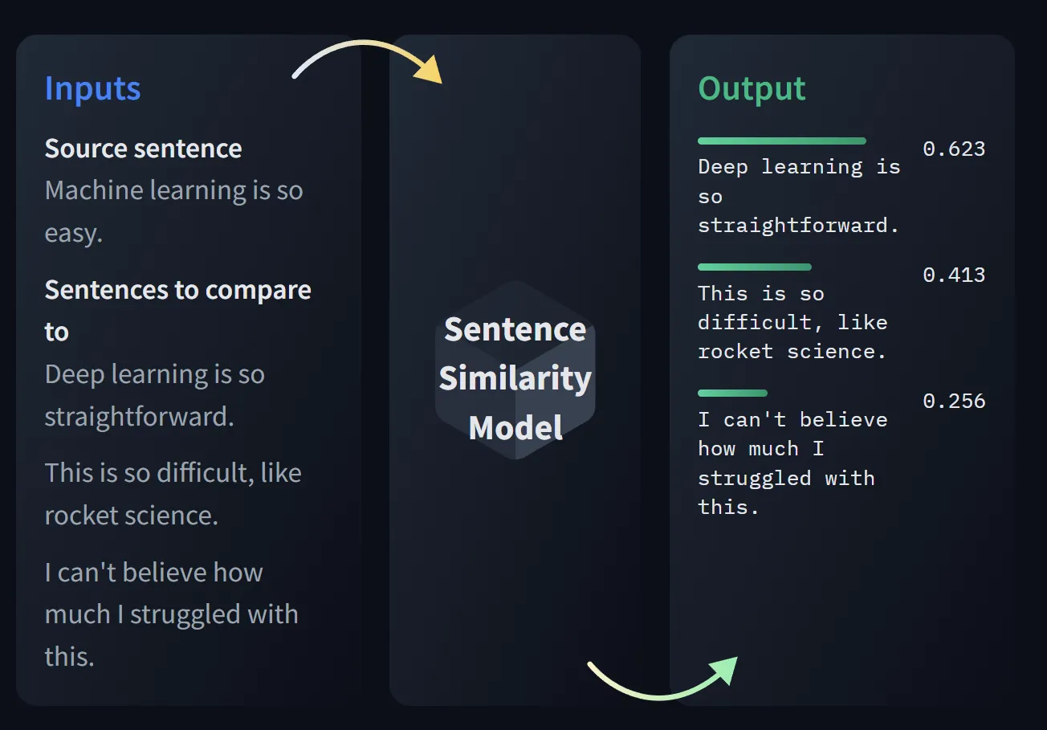
Understanding sentence similarity

Slide 27
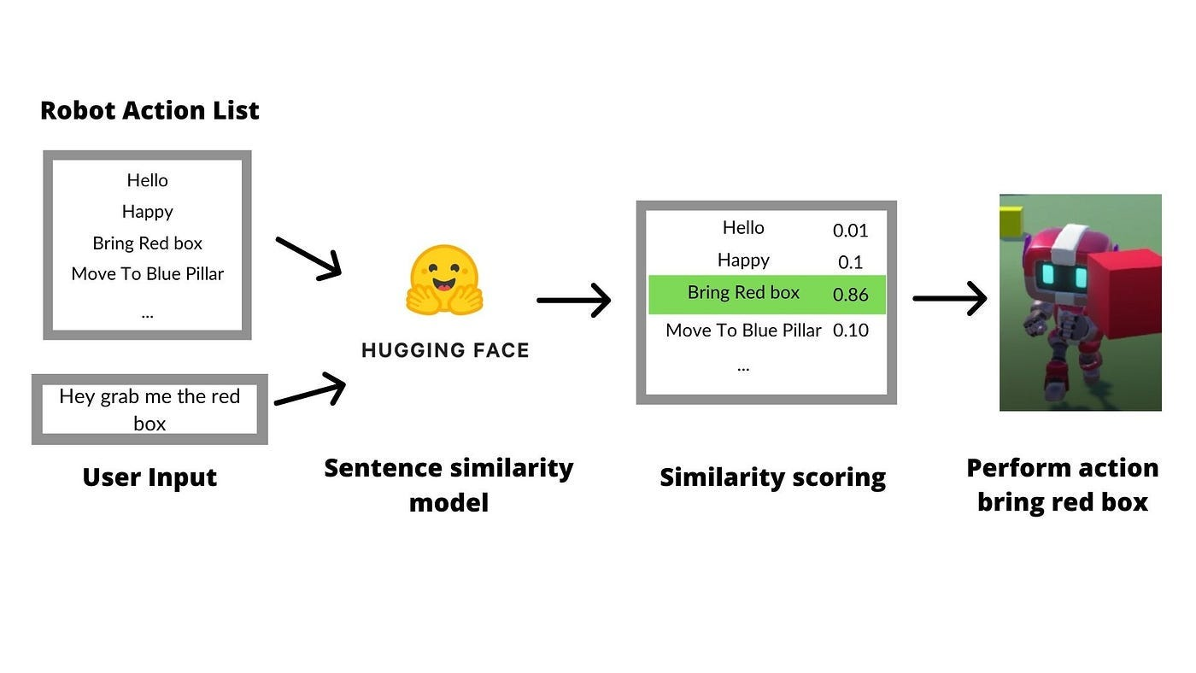
Understanding sentence similarity

Slide 28
Questions

Slide 29
Let’s try to do it in Unity

Slide 30
Practice
Create your Hugging Face account if you don’t have one. https://huggingface.co/join
Check this model: https://huggingface.co/sentence-transformers/all-MiniLM-L6-v2
Download Unity Project: Unity project
Install Unity Sentis versión 1.3 (com.unity.sentis)
Install Sharp Transformers (Add package from git URL:
https://github.com/huggingface/sharp-transformers.git
Check code from:
Code tutorial

